Slide 1
Kicking the Box
Lateral Thinking in the Age of Digital Learning
Rob Kadel, Ph.D.
University of Colorado Denver

Slide 2
Notes:
We don't want to just think outside the box, we want to kick the box away. Think completely differently. Or, if you will, we're going to think laterally. What is lateral thinking?...

Slide 3
Lateral Thinking (a silly example…)
Notes:
The point being that there are lots of answers to the questions you ask. I’m not going to try to lead you down the path to one correct answer today, but rather just get you thinking about alternatives in online and blended courses.

Slide 4
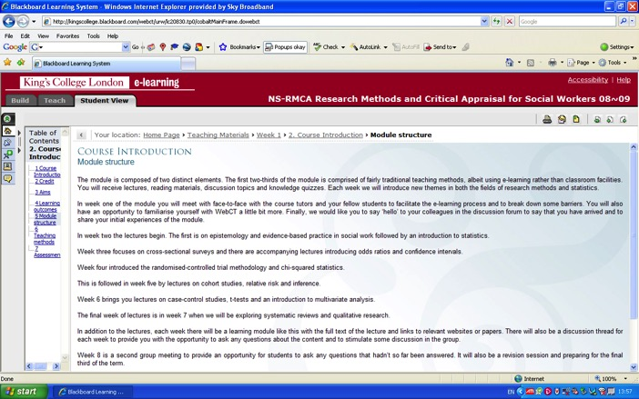
Digital Learning: At Worst

Slide 5
Digital Learning: At Best

Slide 6
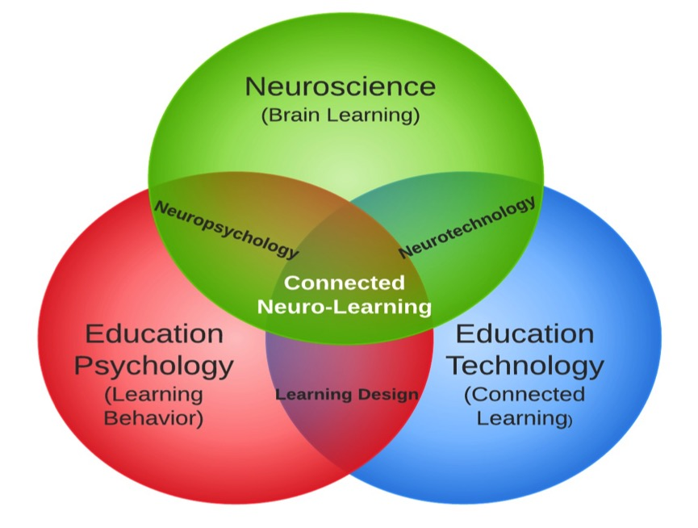

Slide 7
Agenda
21st Century Learning
Effective Practices for Digital Learning
Learning as Narrative
Finding Instructional Assets

Slide 8
21st Century Teaching & Learning
1

Slide 9
Effective Practices for eLearning
http://researchnetwork.pearson.com/library?center=el
http://onlinelearningconsortium.org/publications/workshop_publications
http://blended.online.ucf.edu/blendkit-course/
http://www.unido.org/fileadmin/media/documents/pdf/tcb_roadmap_to__qualitiy_vol1.pdf
http://www.educause.edu/library/resources/state-e-learning-higher-education-eye-toward-growth-and-increased-access

Slide 10
That’s SO 1992…
What’s the best way to lecture & assess my (9, 90, 900) students in class?
Sincerely, 1992
Education Practices:
Lecture
Test
Read
Write

Slide 11
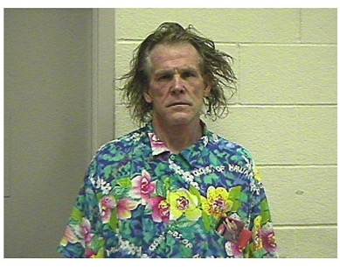
That’s SO 2002…
What’s the best way to lecture & assess my (9, 90, 900) students in class?
Sincerely, 1992
What’s the best way to do what I normally do in the classroom online?
Sincerely, 2002
Education Practices:
Lecture (mostly text based)
Test (Auto-graded)
Read (Text under glass)
Write (No Change)

Slide 12
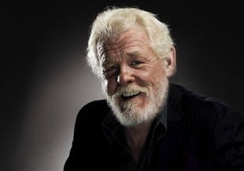
That’s SO 2012…
What’s the best way to lecture & assess my (9, 90, 900) students in class?
Sincerely, 1992
What’s the best way to do what I normally do in the classroom online?
Sincerely, 2002
What’s the best way to learn?
Sincerely, 2012

Slide 13
SAMR Model of Technology Integration (Puentedura)
Notes:
Our analyses of the teacher reports suggests that most teachers are using technology to enhance their known teaching methods. Ruben Puentedura

Slide 14
Connecting an Eco-System

Slide 15
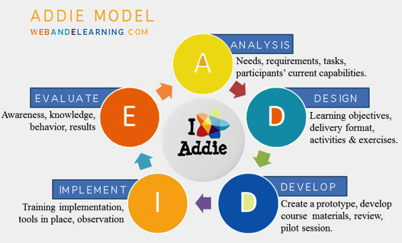
Instructional Design

Slide 16
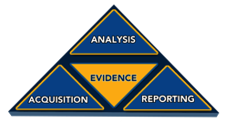
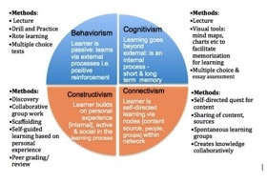
Learning Design
Learning Design
Behavioral Science
Cognitive Psychology
Education Theory
Instructional Design

Slide 17
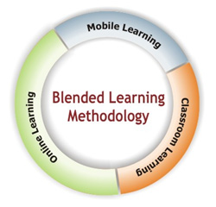
Effective Instructional Practices
Content Creation
Easy Document Storage & Retrieval
Reiteration of Ideas
Collaboration
Extending the Conversation
Creating Connection
Do first…

Slide 18
“Great City” (Chengdu Tianfu)
Notes:
Chinese Pocket City Will Cram 80,000 People Into Half A Square Mile - The entire city will be built from scratch on farmland near Chengdu, China.

Slide 19
80,000 people / .5 sq mile
Notes:
The city's buffer zone has a clear edge, from which the city center can be reached on foot within 10 minutes. It has a network of trails and electric shuttles for people to get around.

Slide 20
100% Green
Notes:
The planned city also has a development program, which aims to cultivate commercial, residential, office and manufacturing space. There will also be a medical campus, which the designers say is intended to help young married couples living with extended families--which can often include two sets of grandparents.

Slide 21
60% less CO2 / 89% less waste
Notes:
Only half the roads in Great City will be allocated to cars, which might not be necessary anyway, because everything will be so close together. All residential units will be within a two-minute walk of a public park, according to AS+GG.
Architect Robert Forest, a partner at the firm, said China is in need of dense, mixed use urbanism--"For the first time in China’s history, more people live in cities rather than rural areas," he said in a statement.
The city is designed to conserve as much existing farmland as possible. It will produce 60 percent less carbon dioxide than conventional cities of the same size, and a whopping 89 percent less landfill waste, according to AS+GG. People will still be able to access other cities using a regional transit hub.

Slide 22
Chengdu Tianfu District: 0 New Schools
Notes:
Chengdu Tianfu is home to a ton of universities, bilingual schools, international schools, etc. So, for one, there’s no need to build new schools. But for another, the planned community will use these newly built resources for education. It is truly education of the future.

Slide 23
What Matters for Education in the Future?
Performance vs. age
Varied assessment / authentic / peer
Multi-modal / Multi-nodal learning
Curriculum integration / multi-disciplinary
Connecting people across ages, disciplines, levels, etc.
Improving learning skills → critical thinking / problem solving → Finding & evaluating information
Open spaces (break down the walls)
Student centric models
Using “non-educators” as models, informants, etc
Different collections of education (outside of a school)
Support: Technical, Learning, etc.
Connect all levels better

Slide 24
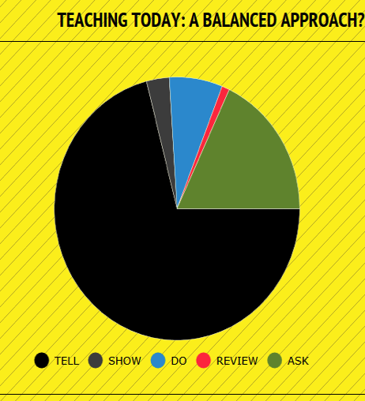
TSDRA

Slide 25
Dan Meyer: Compelling Questions

Slide 26
Compelling Q uestions

Slide 27
Compelling Questions

Slide 28
TSDRA
DO!
SHOW!
TELL!
REVIEW!
ASK!

Slide 29
Effective Digital Learning Practices
2

Slide 30
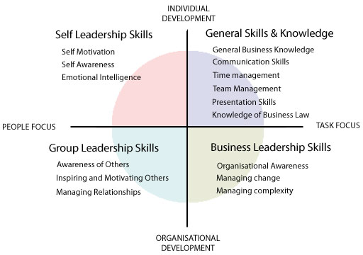
Are Students Life-Ready?
2008 Oxford Survey of “Most Important Employee Skills”
Employers said employees achieved 15% of these regularly

Slide 31
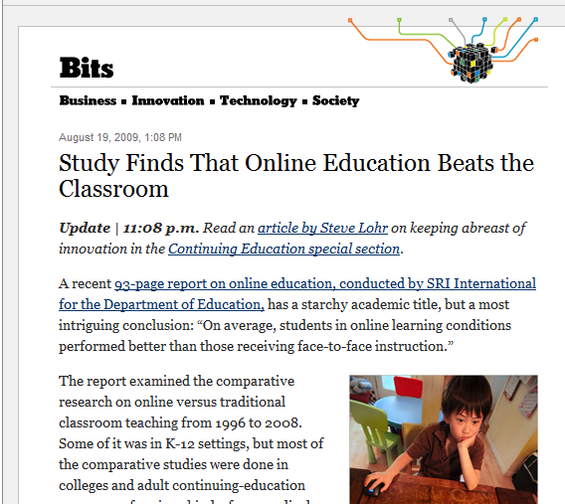

Slide 32
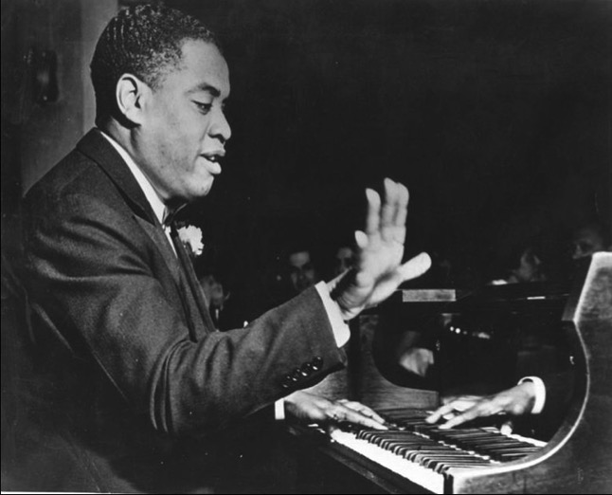
Perception Determines Reality: Les Paul on Art Tatum
Notes:
F# and E were stuck. Every time he did a run down the keyboard, he would reach over and pull those two keys back up with his other hand. “And this cat was blind.”
If you believe something to be a certain way, it will be. If you believe eLearning or online education is inferior, it will be.

Slide 33
Technology Demands Purpose
“Students know when technology without purpose is being imposed on them.”
Allan Heap, Center for Internet Technology
Welding, Telescopes, Automotive, Microscopes, Cadavers, Architecture Software, Bridge Construction Tools, etc.

Slide 34
Multi-Modal Experiences

Slide 35
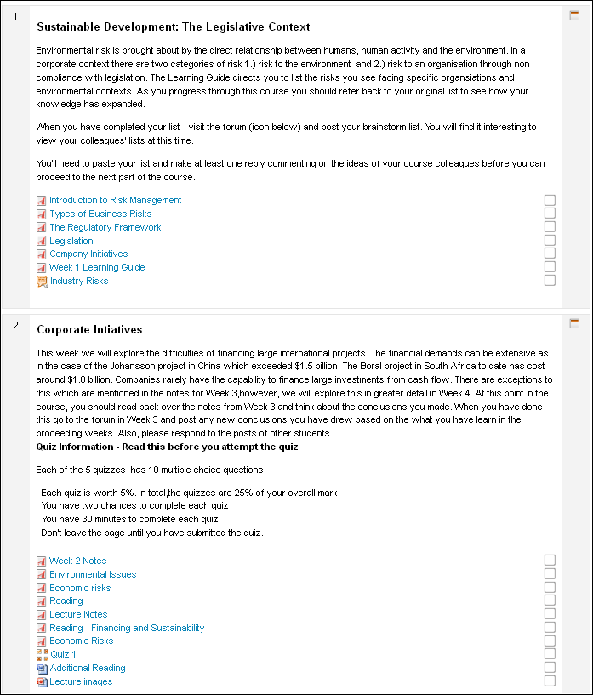
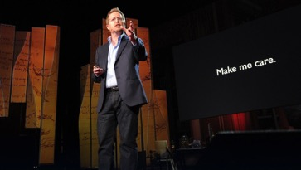
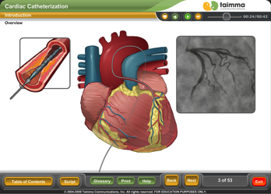
Bad to Good to Great!

Slide 36
How?

Slide 37
Consider Integration of Concepts
Alternate Reality Gaming
Massive Open Online Courses
Curriculum Integration
Problem-based Learning

Slide 38
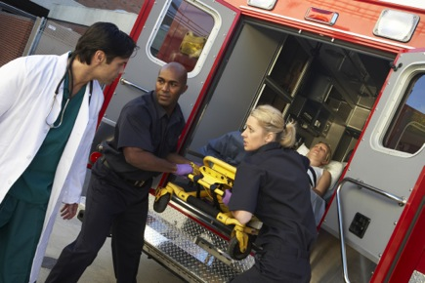
96 Hours Ago…
Notes:
So, here’s an example of challenge-based learning, of saying “You can do more…”

Slide 39
Contagion Speed to Permeation
48 Weeks: 2.6 Billion People

Slide 40
Emergency Health Conference

Slide 41
Contagion

Slide 42
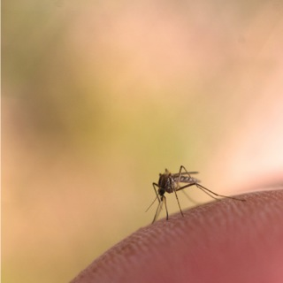
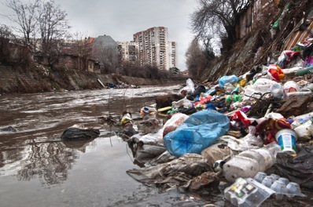
Contagion: ARG / MOOC / CI / PBL

Slide 43
Majors / Emphasis Areas
Biology/Life Science
Political Science/Government
Communication/ELA
Business/Economics

Slide 44
Outcomes
Global Goals
Cultural Sensitivity
Persuasion
Communication
Basic Health Tenets
Etc.
Local Outcomes
???
???
???

Slide 45
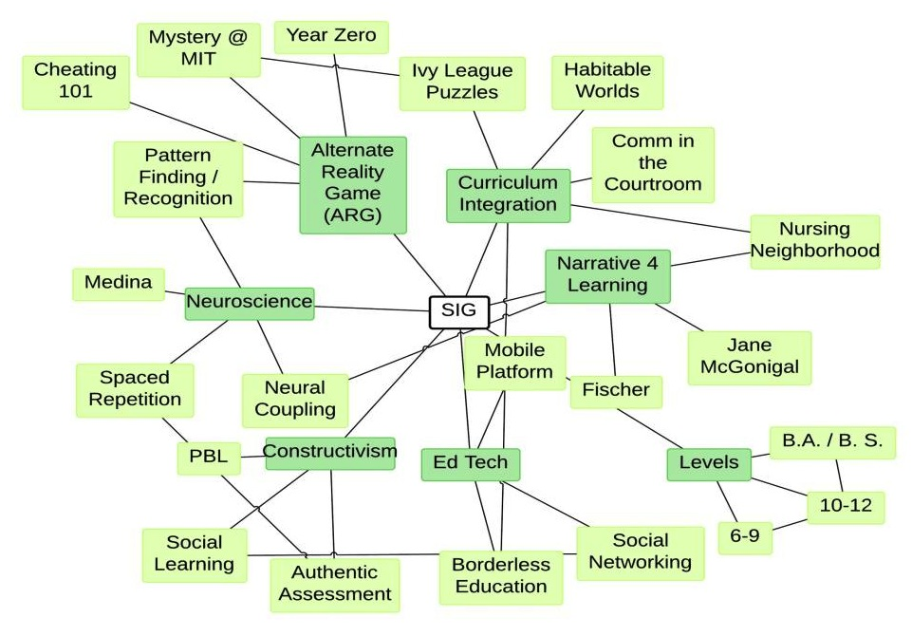
ARLE

Slide 46
SME Board of Directors to Students
SME Board
Instructor Leaders
Student Group Leaders
Student Participants
SME Information Flow
Participant Feedback
Notes:
[BEFORE CLICKING TO NEXT SLIDE] Now, this is not only challenge-based learning, it’s also curriculum integration…

Slide 47
Curriculum Integration Platforms
Defend Murder Suspect
Communications, Law, Forensic Science, Journalism
Discover an Ancient Civilization
Archeology, Anthropology, History, Literature, Language
Catch a Serial Killer
Math, Science, Programming, Psychology
Win The Presidency
Leadership, Accounting, History, Business, Comm, Intercultural
Save Haiti
Government, Economics, Community Health, Ethics
Cornfield Island
Power, Electrical, Health

Slide 48
Choice Drives Constructivism
Flipped Learning
Maker Movement
Challenge Based Learning
Problem Based Learning
Service Learning
Notes:
And to add to challenge-based learning and curriculum integration, we have constructivism and problem-based learning.

Slide 49
Creativity
“Chief Executives believe that – more than rigor, management discipline, integrity, or even vision – navigating an increasingly complex world will require creativity.”
80% of employers seeking creative employees cannot find them to hire…
IBM 2010 Global CEO Survey
1500 CEO’s from 60 Countries

Slide 50
Templatized Education

Slide 51
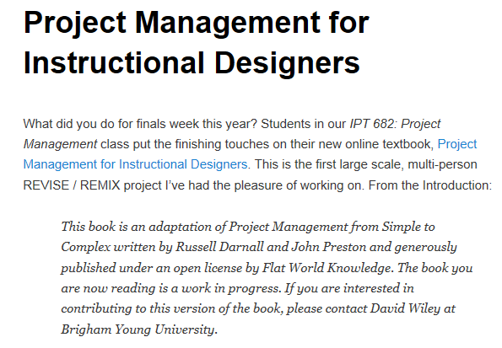
Choose Your Own Textbook
Create Your Own Textbook
Tore out the examples in the book, which were previously about international business situations, and replaced them with instructional design examples,
Tore out the photos from the book, which were previously (c) and used by permission, and replaced them with openly licensed and properly attributed photos (mainly from Flickr),
Shot three video interviews with practicing instructional design project managers and cut these up into topical pieces which now appear inline at the beginning of each chapter,
Created interactive, mastery-check assessments! and embedded these directly at the end of each section of the book. Small icons in the table of contents turn green when you’ve passed the mastery checks.
http://opencontent.org/blog/archives/2119

Slide 52
Customized Content
http://youtu.be/7idyNIvVCis?list=PLy6xIE2-SrEkoHwjXvIz0R7QLaUQXcaII and watch from 00:10 to 01:21
Notes:
http://youtu.be/7idyNIvVCis?list=PLy6xIE2-SrEkoHwjXvIz0R7QLaUQXcaII and watch from 00:10 to 01:21

Slide 53
Authentic Experiences
Goals: Research, community connection, evaluation of historical practices, collaboration, analysis / synthesis of effectiveness, etc.
Assignment 1: Please create a 3-5 page paper, detailing the history of our school, town, or state. This paper should paint a picture…
Assignment 2: Upload a historical artifact to www.historypin.com
Notes:
Historypin.com is like Pinterest but specifically for sharing historical facts, ideas, and artifacts.

Slide 54
History Pin (Creative Assessment)

Slide 55
Remember: How are students learning and interacting outside of school?

Slide 56
Remember: How are students learning and interacting outside of school?
Notes:
All of these tools on the left are teaching students many of the same skills on the right that we want them to have.

Slide 57
Narrative: Effective Practices
3

Slide 58
Immediacy Contextualizes
Immediacy = Connection
People Like (Learn From) People…
Pets
Kids
Hobbies
Subject Matter into Real Life
Notes:
Immediacy: “The perceived physiological or psychological closeness in the sender / receiver relationship”

Slide 59
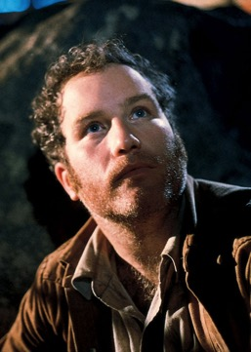
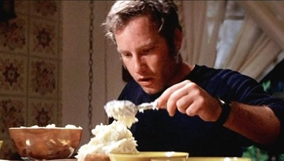
Narrative
Story
Connection
Immediacy
Close Encounters

Slide 60
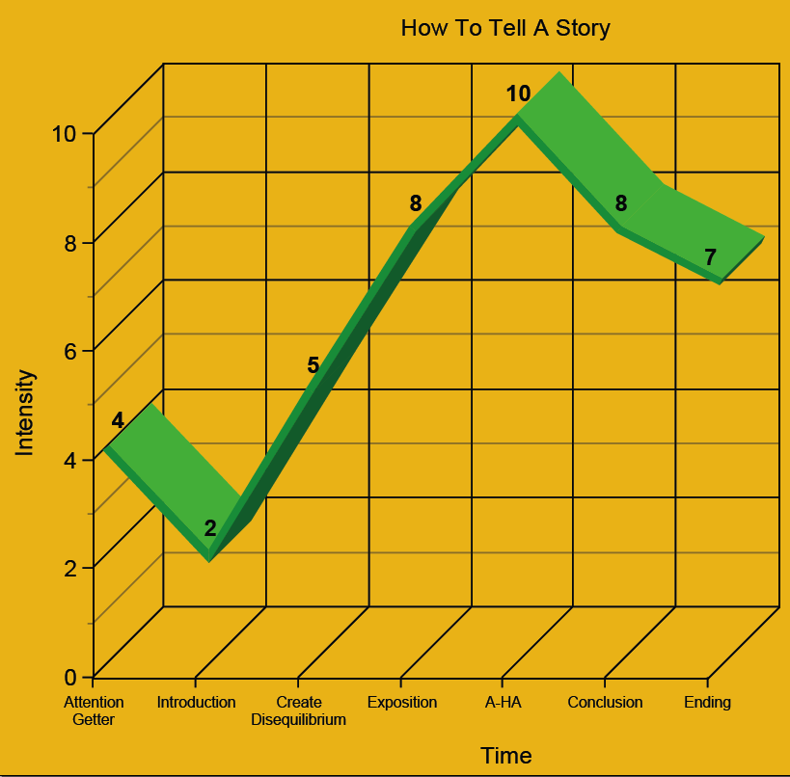
How Do We Tell GOOD Stories? (Quincy)

Slide 61
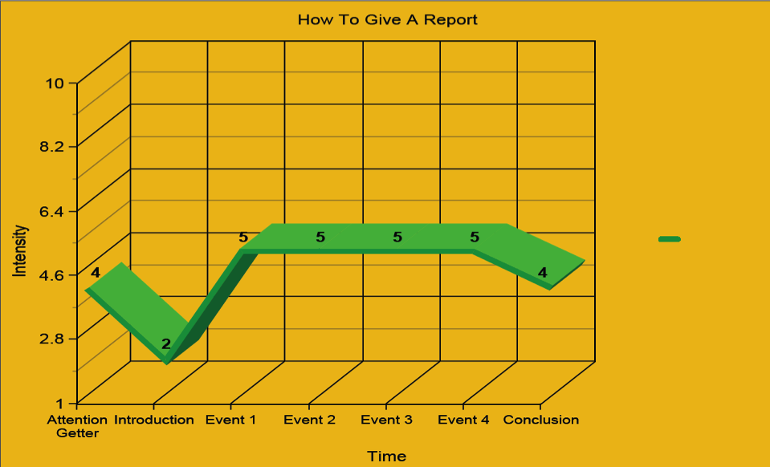
How NOT To Tell A Story

Slide 62
What’s Your Story?

Slide 63
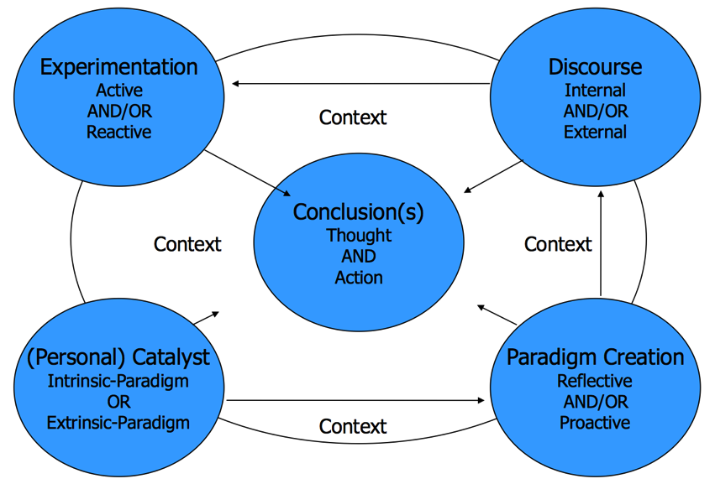
Transformative (Human) Learning
Notes:
Jack Mezirow

Slide 64
Finding Instructional Assets
4

Slide 65
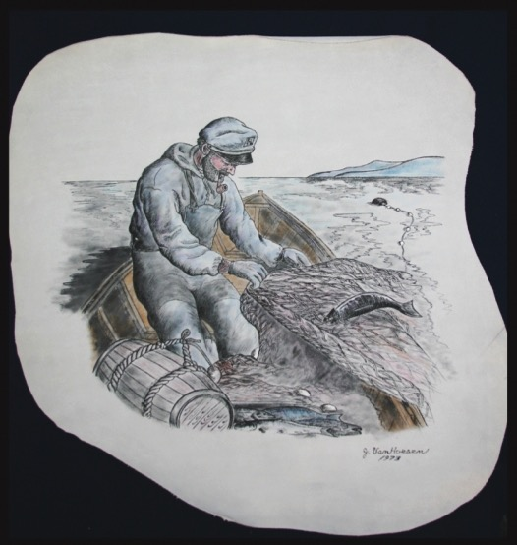
Teaching You To Fish
Aggregators
Social Bookmarking
Searching
Filter Bubbles

Slide 66
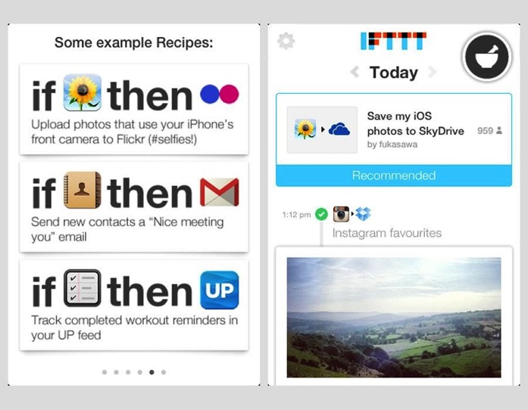
IFTTT

Slide 67
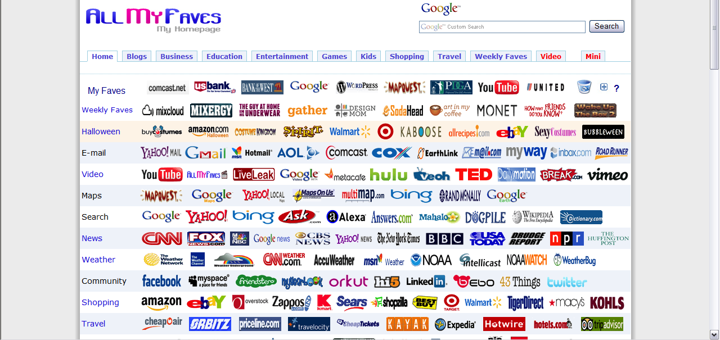
AllMyFaves (allmyfaves.com)

Slide 68
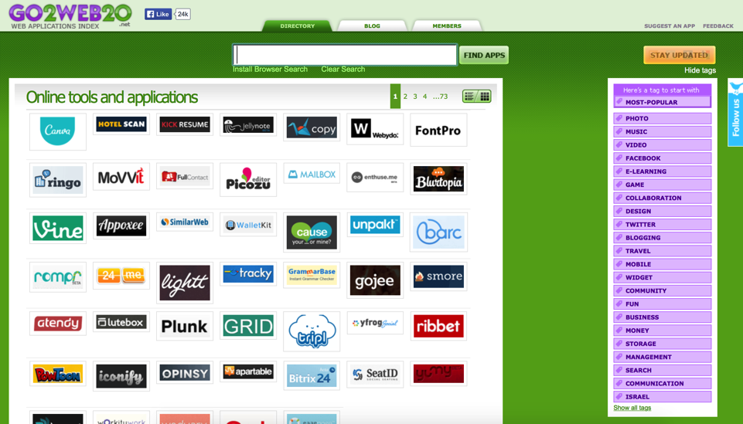
Go2Web20 (go2web20.net)

Slide 69
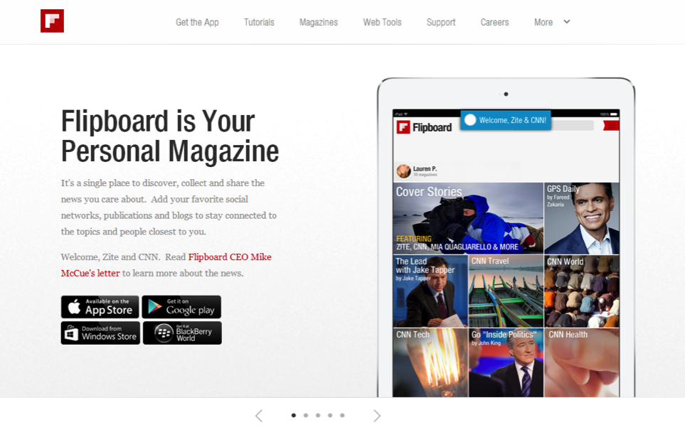
Flipboard (flipboard.com)
Notes:
ABOUT THE APP
Desktop / IOS / Android / Windows 8
News aggregation
Subscribe to news feeds
Create personalized magazines
Zite is specialized to deliver content Flipboard delivers full sites/blogs/news
CLASSROOM USES
Keep up on current information
Class project magazine (invite contributors)
Educational resources (personal or collaborative use)
Class syllabus
School magazine

Slide 70
Pocket (getpocket.com)

Slide 71
Delicious (delicious.com)
Notes:
ABOUT THE APP
App Desktop / IOS / Android
Social bookmarking
CLASSROOM USES
Saving ideas to access later
Group projects within a class
Shared resource for a department

Slide 72
Diigo (diigo.com)
Notes:
ABOUT THE APP
App Desktop / IOS / Android
Social bookmarking
CLASSROOM USES
Saving ideas to access later
Group projects within a class
Shared resource for a department

Slide 73
StumbleUpon (stumbleupon.com)
Notes:
ABOUT THE APP
App Desktop / IOS / Android
Social bookmarking
CLASSROOM USES
Saving ideas to access later
Group projects within a class
Shared resource for a department

Slide 74
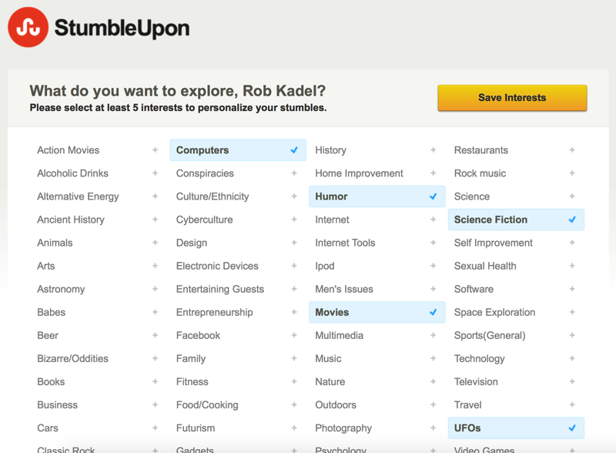
StumbleUpon (stumbleupon.com)
Notes:
ABOUT THE APP
App Desktop / IOS / Android
Social bookmarking
CLASSROOM USES
Saving ideas to access later
Group projects within a class
Shared resource for a department

Slide 75
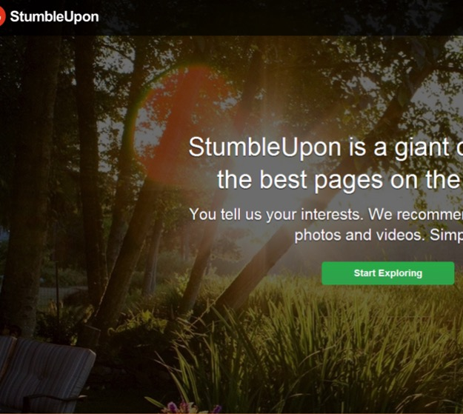
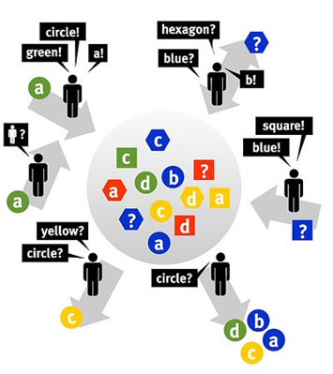
Social Bookmarking
Notes:
ABOUT THE APP
App Desktop / IOS / Android
Social bookmarking
CLASSROOM USES
Saving ideas to access later
Group projects within a class
Shared resource for a department

Slide 76
Notes:
The point being that there are lots of answers to the questions you ask. I’m not going to try to lead you down the path to one correct answer today, but rather just get you thinking about alternatives in online and blended courses.

Slide 77
Thank you!
Rob Kadel, Ph.D.
rob.kadel@ucdenver.edu
Twitter: @rkadel42
Web: robkadel.com

